Slide 1
Year Out Research Programs Information Session
September 30, 2021
5:45 – 6:45 PM
Mark Neuman, MD, MSc
Associate Faculty Director
Medical Student Scholarship and Research
mark.neuman@uphs.upenn.edu

Slide 2
Research and Other Scholarly Opportunities
Summer Research
See the videos and slides from Intro to Research at Penn Series
Scholarly Pursuit (MS3/4)
Year Out (following MS3)
MD/Master programs
MBE, MBA, ML, MPH, MSCE, MSHP, MSME, MSTR
MD/PhD program

Slide 3
Tonight’s Session
Year out programs - why consider doing one?
Where to find more information
Some great examples
Center for Precision Medicine @ Penn
NIDDK Medical Student Research Training Program @ Penn
Pathology Fellowship @ Penn
FOCUS in Women’s Health Research
Jeffrey W. Berger Award Ophthalmology Research
Sarnoff Cardiovascular Research Foundation
Student panel
Q&A until we drop

Slide 4
Why should you do this?
Life changing
Career building
Residency planning
Training in critical thinking
Satisfies Scholarly Pursuit requirement
Fun

Slide 5
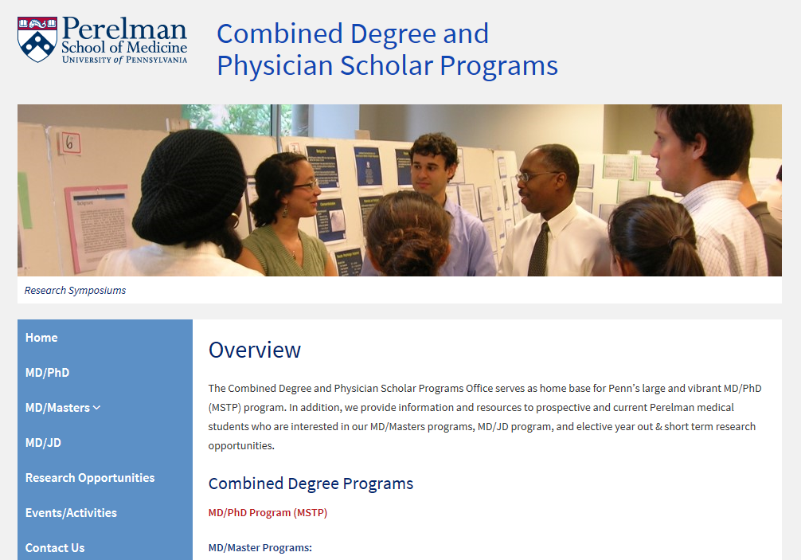
http://www.med.upenn.edu/educ_combdeg/

Slide 6
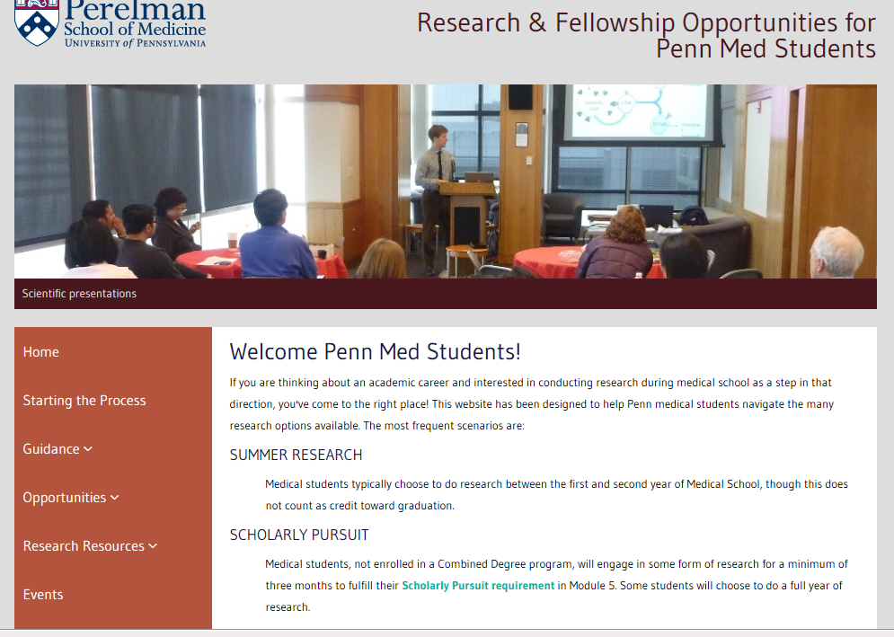
http://www.med.upenn.edu/mdresearchopps/

Slide 7
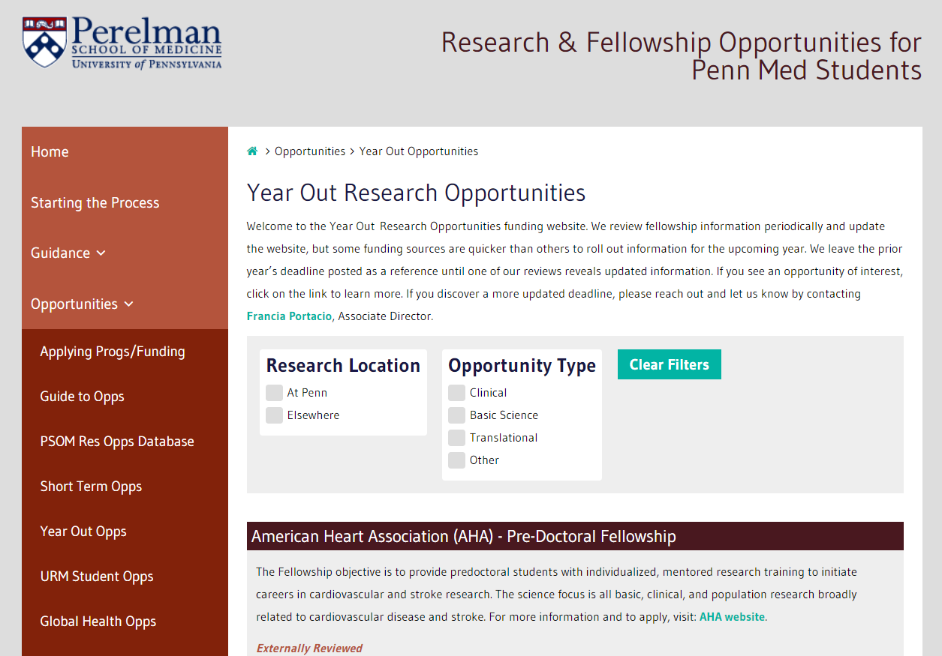
http://www.med.upenn.edu/mdresearchopps/

Slide 8
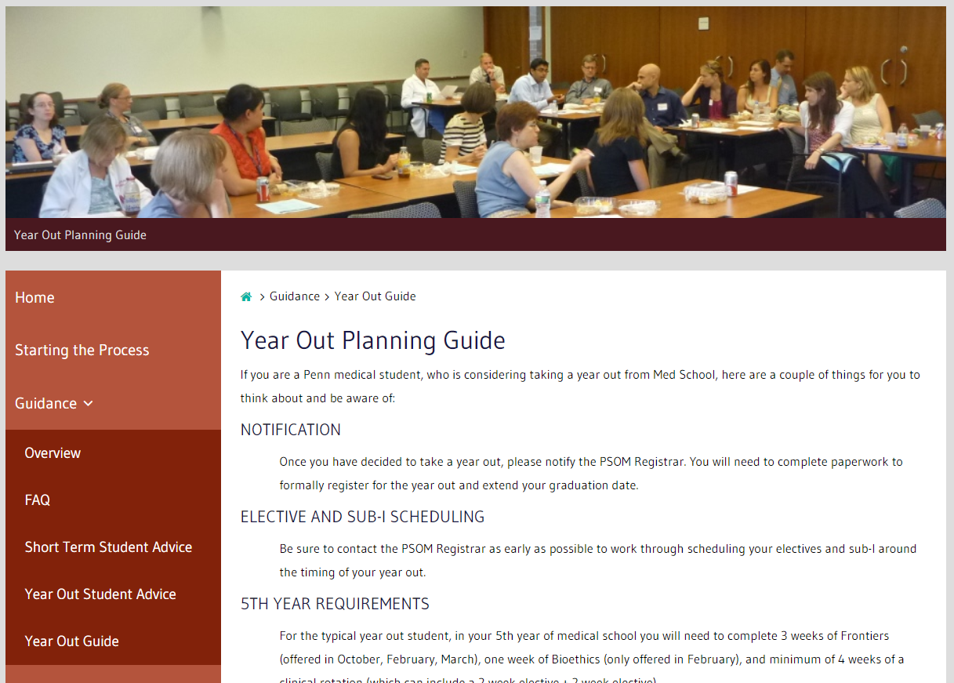
http://www.med.upenn.edu/mdresearchopps/

Slide 9
Contact Us
Dr. Skip Brass: Lawrence.Brass@pennmedicine.upenn.edu
Dr. Mark Neuman: Mark.Neuman@uphs.upenn.edu
Francia Portacio: Francia.Portacio@pennmedicine.upenn.edu
Combined Degree Office: 6th Floor JMEC
http://www.med.upenn.edu/educ_combdeg/

Slide 10
Year Out Research Programs
Sample of Programs:
PCPM Research Fellowship - Dr. David Roth
NIDDK MSRT - Dr. Jonathan Katz
Pathology Year Out Fellowship - Dr. Cindy McGrath
FOCUS Research Fellowship - Dr. Hillary Bogner
Ophthalmology Research - Dr. Daniel Dunaief
Sarnoff Cardiovascular - Dr. Megan Burke

Slide 11
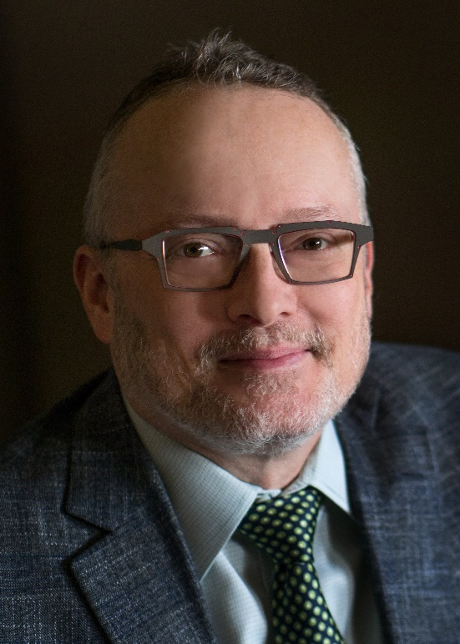
PCPM Research Fellowship: David Roth, MD, PhD
Simon Flexner Professor and Chair, Department of Pathology and Laboratory Medicine
Director of Penn Center for Precision Medicine (PCPM)
David.Roth2@pennmedicine.upenn.edu

Slide 12
Penn Center for Precision Medicine (PCPM) Research Fellowship Program
Dr. David Roth, MD, PhD
Director, Penn Center for Precision Medicine
Chair, Pathology & Laboratory Medicine

Slide 13
PCPM Research Fellowship Program
Program Overview
Center leadership will work with selected candidate to design a research experience in precision medicine related to the medical student’s interest.
Other Information
Paid research fellowship with a monthly stipend of $3,000 plus student health insurance
1 fellowship position per year
Applications Deadline: May 1, 2022
Contact: Dr. David Roth at David.Roth2@pennmedicine.upenn.edu

Slide 14
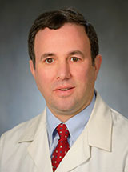
NIDDK MSRT: Jonathan Katz, MD
Associate Professor of Medicine
jpkatz@pennmedicineupenn.edu

Slide 15
NIDDK Medical Student Research Training Program (MSRT)
NIDDK is one of nearly 30 NIH Institutes/Centers
Penn Research within NIDDK Mission:
Basic sciences: Gastroenterology/Hepatology (Katz), Diabetes, Endocrine & Metabolic Dis. (Cappola), Hematology (Tong), Renal (Holzman), Biostatistics - Renal & Urologic Diseases (Shults)
Epidemiology: Gastroenterology (Lewis), Nephrology (H. Feldman)
Overview:
Basic science/translational research at Penn – open to Penn and non-Penn students
4 fellowship spots available; program is 9 – 12 months long
Stipend is over ~$24,000/full year + funds for travel to scientific meeting, research support, and health insurance
Application: pre-application due: March 15, 2022
Contact: Dr. Jonathan Katz - jpkatz@pennmedicine.upenn.edu

Slide 16
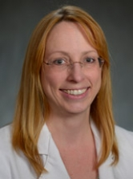
Pathology Year Out Fellowship: Cindy McGrath, MD
Professor of Clinical Pathology and Lab Medicine
cindy.mcgrath@pennmedicineupenn.edu

Slide 17
POST-SOPHOMORE FELLOWSHIP PROGRAM IN PATHOLOGY AND SCHOLARLY PURSUIT
University of Pennsylvania Medical Center Department of Pathology & Laboratory Medicine
Cindy McGrath, MD
Professor, Academic Clinician
Director of Student Fellowship in Pathology

Slide 18
Student Fellowship Program in Pathology
Unique work-study experience
Experience and education is beneficial to ANY future career
Year long program includes rotations in Anatomic and/or Clinical Pathology in which the student fellow takes on clinical responsibilities comparable to that of a first-year resident PGY-1 for 9 months, in addition to:
Dedicated research project of choice for 3 months with guidance and mentoring provided—typically results in national meeting presentation and publication
Fellowship is tailored to the individual’s interests with appropriate rotations and electives
Fulfills Scholarly Pursuit Requirement
Stipend: $27,000 + Student Fees + Insurance (apply towards following year’s tuition or as a monthly stipend)
Application (Sept thru Jan preferred for upcoming start June/July), CV, references, interview (2 positions)
cindy.mcgrath@pennmedicine.upenn.edu
Recent student fellows: Travis Hoover, Caroline Kim, Joseph Kim, Mike Baer, Esther Baranov, Clayton Marcinak

Slide 19
Student Fellowship Rotations
Anatomic Pathology
Surgical Pathology
Cytopathology
Medical Pathology or Autopsy
Clinical Pathology or Laboratory Medicine
Transfusion Medicine
Hematopathology
Coagulation
Chemistry
Immunology
Microbiology
Molecular Pathology/ Center for Personalized Diagnostics
√
√
√
√
√
Medical Examiner’s Office
Dermatopathology
Pediatric Pathology
GI Pathology
√
√

Slide 20
Student Fellowship Program in Pathology

Slide 21
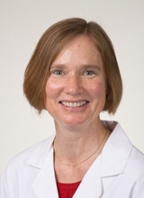
FOCUS Research Fellowship: Hillary Bogner, MD, MSCE
Associate Professor of Family Medicine and Community Health
bognerh@uphs.upenn.edu

Slide 22
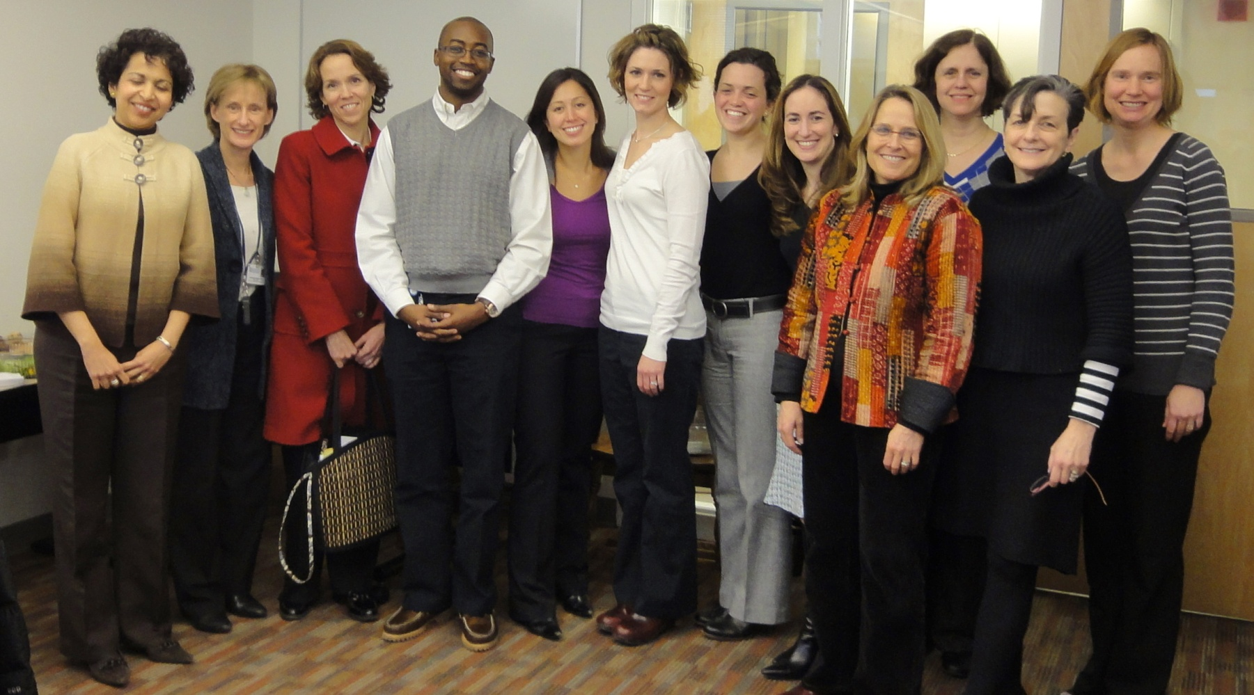
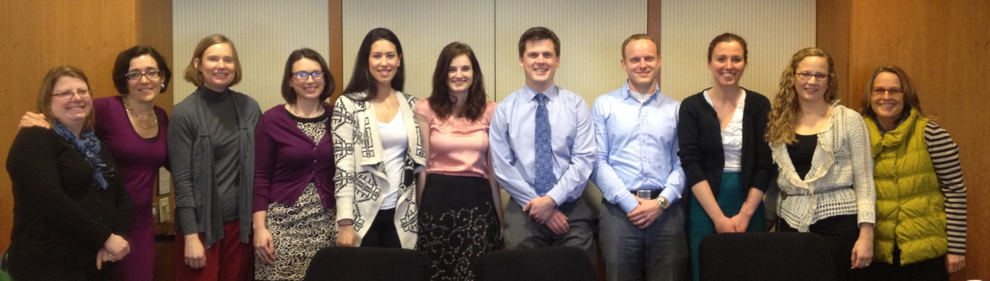
FOCUS Medical Student Fellowship in Women’s Health Research
Website: www.med.upenn.edu/focus/StudentFellowships.shtml
Contacts: Hillary Bogner MD MSCE & Susan Primavera

Slide 23
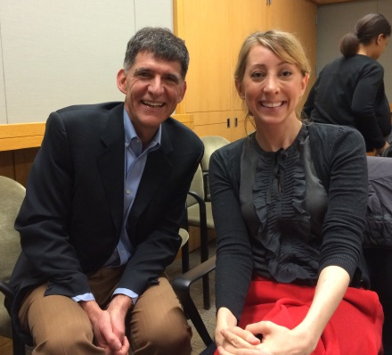
FOCUS Medical Student Fellowship
Contacts: Hillary Bogner MD & Susan Primavera Web: www.med.upenn.edu/focus/StudentFellowships.shtml
Offers between 3 and 6 awards annually
Range of study in women’s health, defined broadly; one award may be specific to CV research
Clinical, basic science or community-based research project
Open to ALL (men and women) medical students who have completed clinical clerkships
Majority begin in summer or fall after completing 3rd year- some flexibility
Funding for 6 months of mentored, intensive women’s health research
Months do not need to be continuous; can be broken up
Student award totals $7500 ($1250 per month)
Penn faculty mentor on one of the fulltime academic tracks; students identify mentor prior to applying; consistent meetings
Three research/networking luncheon-meetings to discuss projects and career goals
Fulfills scholarly pursuit curriculum requirement
Potential to apply toward a Year Out and/or Women’s Health Scholar Certificate

Slide 24
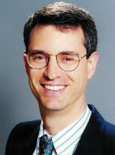
Jeffrey W. Berger Award, Ophthalmology: Joshua Dunaief, MD, PhD
Adele Niessen Professor of Ophthalmology
jdunaief@pennmedicine.upenn.edu

Slide 25
Post 3rd year Fellowships in Ophthalmology
Scholarly Pursuit in 4th year or year out after 3rd year
Basic, translational, or clinical science research
Funding through Jeffrey W. Berger Foundation, Research to Prevent Blindness (RPB), or individual Principal Investigators
Visiting research fellowship available at Hadassah Hospital, Jerusalem for year out after 3rd year.
For basic/translational research: jdunaief@pennmedicine.upenn.edu or dunaieflab.org
For Clinical research: Prithvi.Sankar@pennmedicine.upenn.edu
Deadline for most awards is Dec 1. For Hadassah opportunity, deadline is Oct 15.

Slide 26
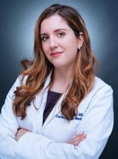
Sarnoff Cardiovascular :
Megan Burke, MD
Fellow in Cardiology
Megan.Burke2@pennmedicine.upenn.edu

Slide 27
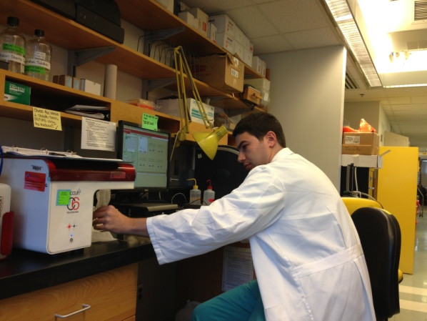
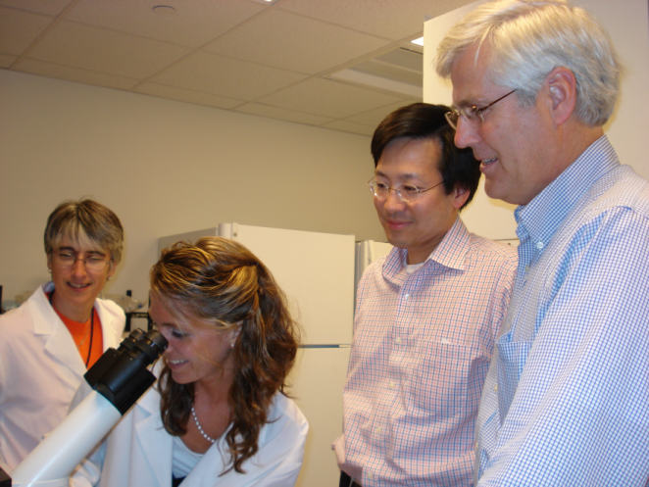
Sarnoff Fellowship
Sarnoff Fellows spend a year conducting intensive work in a research laboratory
Although applicants may have prior research experience, applications are also encouraged from students without extensive prior research experience
Notes:
Dr. Sarnoff designed the fellowship for medical students without extensive prior research experience, but students with experience obviously are also encouraged to apply.
An unique aspect of the fellowship is that students spend a year conducting research in a laboratory at an institution other than their own. This allows the medical student to experience a different academic environment and remove any barriers to working in a high quality lab. The Sarnoff Foundation will fund students with extenuating circumstances (such as family commitments) who wish to stay at their medical school.

Slide 28
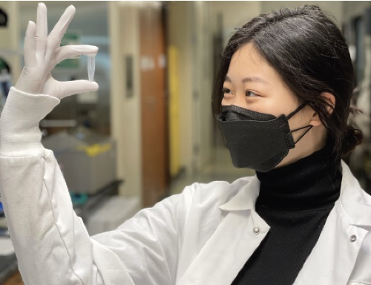
Sarnoff Benefits
Annual stipend - $35,000
Fellowship Allowance - $8,000
Financial support to attend the Annual Scientific Meeting and the AHA Scientific Sessions
Additional funds to present research at up to two national conferences
Notes:
The current annual stipend for the fellowship is $35,000 which are provided as monthly payments.
An applicant is not expected to have chosen a laboratory before receiving the fellowship. After a fellow has been granted the fellowship, he or she will work with the Scientific Committee advisor to choose a number of laboratories that would provide an optimal research experience. Up to $8,000 is provided for travel expenses related to these lab visits, moving expenses, and health insurance.

Slide 29
Sarnoff Application
Personal Statement
Essay
Curriculum Vitae
Transcript
Sponsor’s Endorsement
(Member of applicant’s medical school faculty)
Letters of Recommendation
Notes:
Applications for the 2020-21 Sarnoff Fellowship Program are due on January 12, 2022. They include:
-a one page personal statement
-a three page essay, consisting of the following components:
In one page, describe a specific clinical or scientific question or problem relevant to cardiovascular medicine that you find important or interesting. (Note: this problem does not necessarily define or constrain the research topic you will explore during your Sarnoff year)
In two pages, describe 2-3 approaches to examining the problem.
-a CV and medical school transcript
-a letter of endorsement from a member of your medical school faculty who will serve as your “sponsor.” He or she is responsible for assisting you in preparing your application, especially your essay, and for advising you on your laboratory selection along with your Scientific Committee advisor.
-and, letters of recommendation from individuals that can comment on your abilities as an inquisitive and critical thinker.
After the applications are reviewed, up to 20 applicants will be invited for interviews with the Scientific Committee in early March 2022. Up to 12 medical students are granted Sarnoff Fellowship awards. The Scientific Committee places major emphasis on an applicant’s interest in a career in cardiovascular-related research and the ability to reason critically in a scientific fashion.

Slide 30
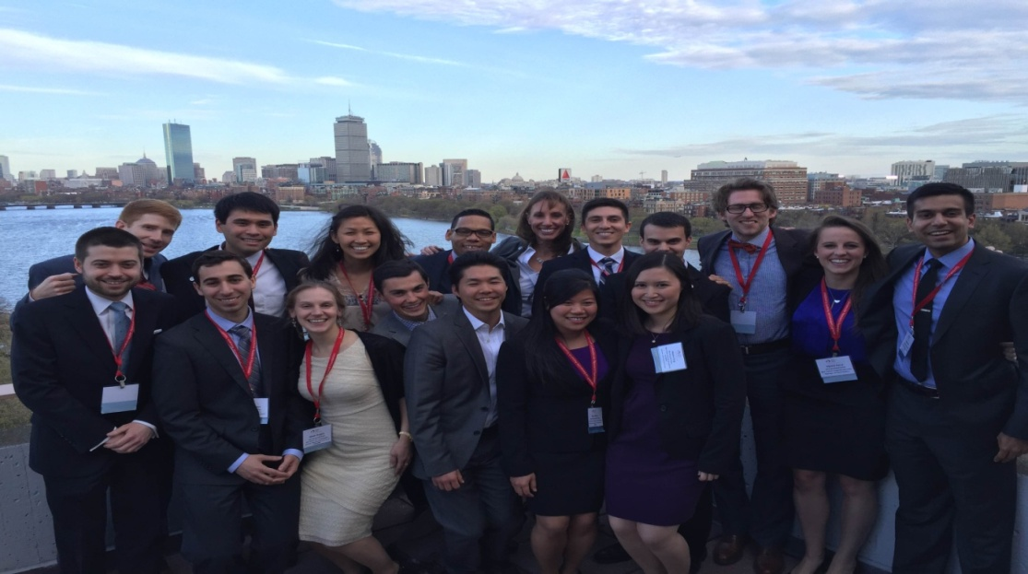
The Sarnoff Advantage
Can conduct research any where in the US
Lifelong Alumni support and offerings
Lifelong mentoring by top physician scientists in the country
Large Alumni Network

Slide 31
Contact Information
Dana Boyd, Executive Director
Sarnoff Cardiovascular Research Foundation
dboyd@SarnoffFoundaton.org
(703) 759-7600
www.sarnofffoundation.org
Notes:
Applications for the Sarnoff Fellowship Program must be submitted online on the Sarnoff website. The website also contains names of potential Sponsors at most US medical schools. You may also contact Dana Boyd for more information.
Thank you for your interest. I’ll be happy to answer any questions.

Slide 32
Year Out Research Student Panel
Year Out 2021-2022 Students:
Name | Funding
Nico Pascual-Leone | Leon Root Research Fellowship
Sara Hobday | Otorhinolaryngology Department
Emily Lawrence | Ophthalmology Research (partially funded by NHLBI)
Year Out 2020-2021 Students:
Name | Funding
Vivek Nimgoankar | Penn Center for Precision Medicine Medical Student Fellowship
Resident:
Name | Department
Joe Kim, DO | Pathology

